Slide 1
Find these files
How to use this stupid tool

Slide 2
Basic Idea
First open ftf.exe
The whitespace on the left is where you’ll add files that you want to check to see if they are duplicated in…
…the whitespace on the right. In this space you’ll add you search folder (ie clients folder) and it will show you the relevant matches.
Click a file on the left and the matches will appear on the right.

Slide 3
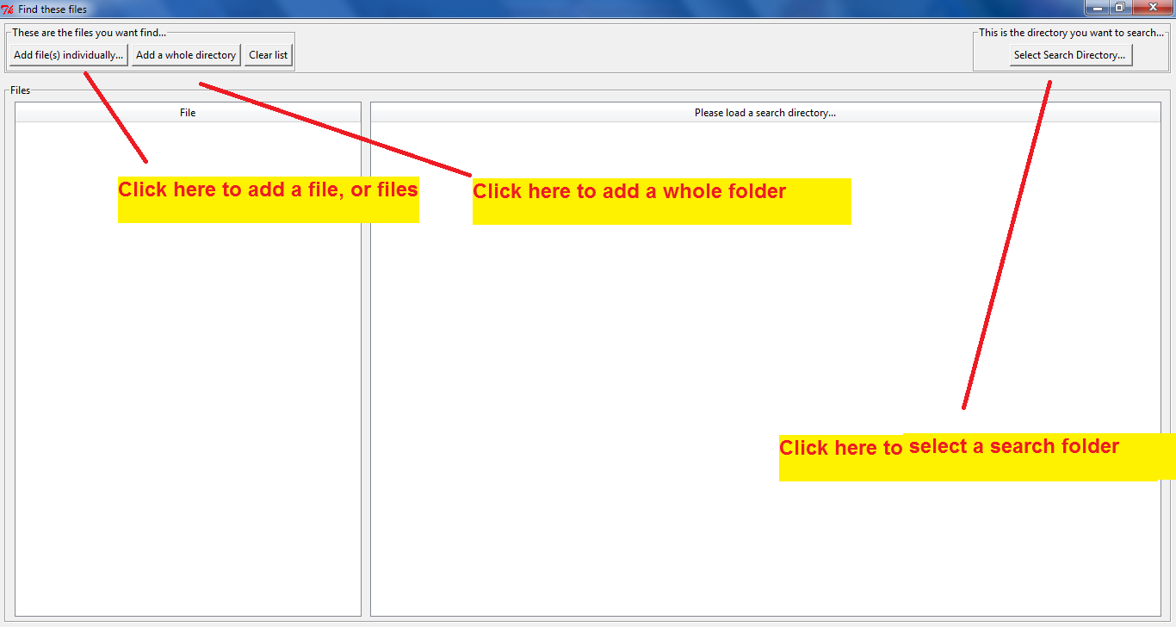

Slide 4
Loading
When you load a big directory, it might take a while to capture all the file names
Just be a little patient, then its pretty smooth sailing

Slide 5
